Slide 1

Can a Random Forest Model Accurately Predict Comebacks in the NFL?
Christopher Dillard
BAN 592

Slide 2

What is the aim of this project?
If teams don’t have a realistic chance of making a comeback in the second half, then why should the game go on?
By running a Random Forest model, I intend to predict the odds that the team losing at Halftime makes a comeback and ultimately wins the game, specifically at different point differentials.

Slide 3
What’s in the data?
The data I will be working with is a combination of play-by-play data from the NFL, seasons 2018-2022, that I named pbpfull.
This behemoth of a dataset contains 245,281 rows of data and 372 variables. Since my laptop can only handle so much at once, this needed some adjustments and filtering.
There were a ton of missing values throughout the dataset, although not enough to greatly change the row count if I deleted them.
As for NAs in Wind and Temp, these indicate games played inside, so I replaced the NAs with 0 and 70, respectively, since these seem logical…

Slide 4
Quick facts
Descriptive Analytics
After dealing with Nas in the selected variables and storing all subsequent changes into pbp_cleaned…
There were 1372 unique games.
81 of those games went into overtime.
7 of those games, remained a tie.
341 games (not including overtime ties) resulted in a comeback or about…
25% of all games in the dataset.

Slide 5
Variables added to the dataset
Half_Time
A binomial variable with 1 representing the play at half time and 0 being the rest.
Determined by the play where qtr ==2 and quarter_seconds_left is closest to zero.
Made_a_Comeback
Also binomial with “Yes” or “No”.
Comebacks are NOT games that ended in unresolved ties in overtime (qtr==5). These 7 games were eliminated from the dataset.
htptdif
The absolute difference of the score at Halftime.
htptdifgroup
Categorical variable to segment the absolute difference into:
1. Tied at HT
2. <Five (1-5)
3. Six-Ten
3. Eleven-Fifteen
4. Sixteen-Twenty
5. Twentyone-Twenfive
6. >Twentyfive
*Important Note*
A LOT of variables had to be dropped when creating pbp_cleaned, many of which had NAs that just would not work with my model.
With these new variables there is a total of 34.

Slide 6
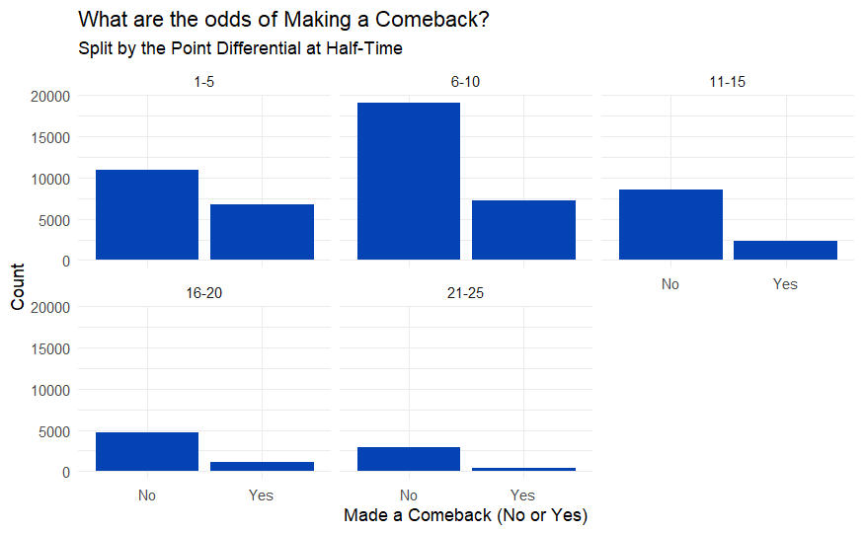
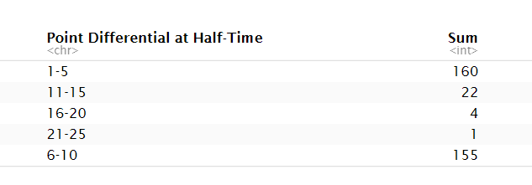
Quantifying Comebacks by Point Differentials at Halftime
Total games that resulted in Comebacks, split by how many points the team was losing by during Half-Time

Slide 7
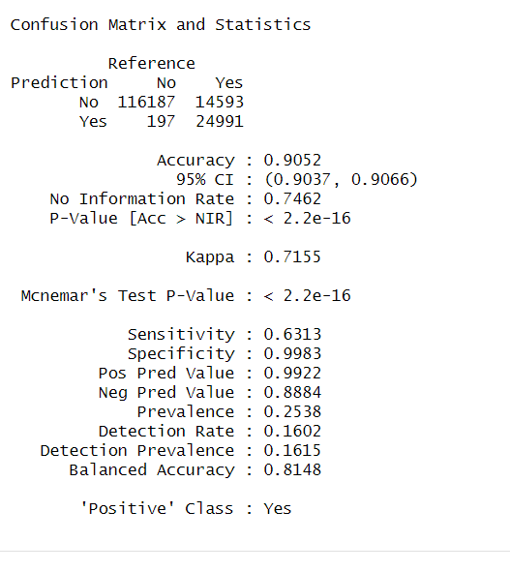
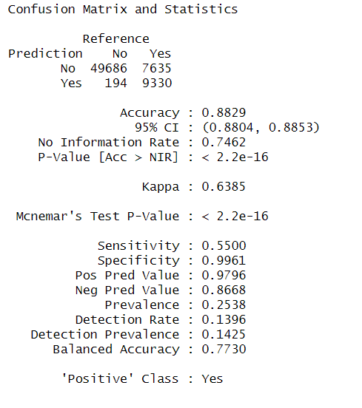
Random Forest model performance
The model was trained on 70% of the pbp_cleaned rows with 14 different predictor variables to predict a “Yes” for Made_a_Comeback.
The model was 91% accurate on the training set and 88% percent accurate on the testing set.
Accuracy on the Training Set
Accuracy on the Testing Set

Slide 8
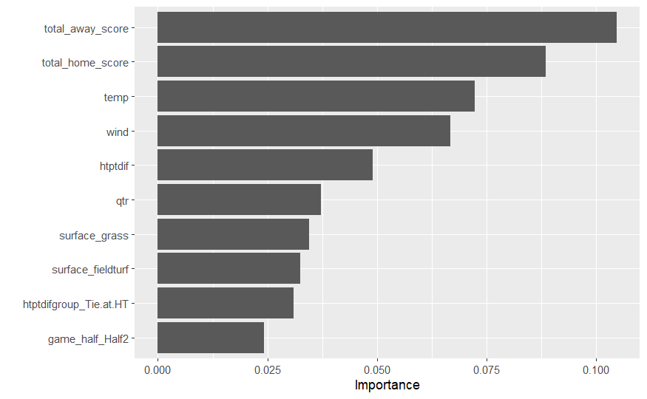
What were the most important variables?
The current (total) running score to determine who is in the lead is on top.
Interestingly enough, temp and wind appear to have a comparatively large impact on the model.
The score differential at half-time is important as well…

Slide 9
Findings and closing remarks
Accuracy
Repeatability
Practicality & Implications
The model did not perform as accurately on the testing set (88%) as it did on the training set (91%).
Play-by-play data is full of many variables which, although valuable, can complicate the variable selection process for the model.
I joined 5 years of data from nflverse on Github, which is presumably updated annually.
As long as the new variables I created are kept in mind, the model can be fed more data once the nflverse repository is updated to help improve its accuracy.
In theory, predicting whether a team makes a comeback is highly plausible, but computationally intensive.
With a better computer to run a more robust model, a Random Forest model can definitely handle making better predictions.

